Slide 1

“ANALYSIS OF STUDENT DATA AND PERFORMANCE USING SAS”.
Done By –
Prashali S. Shinde Roll No. 20
Priti R. Dhavale Roll No. 04

Slide 2
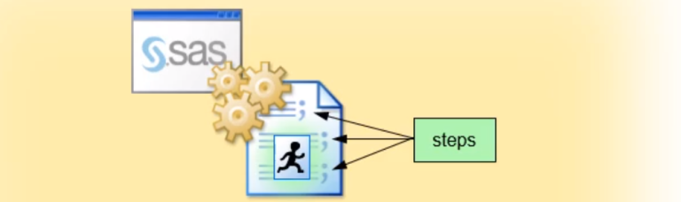
Sas overview :
Integrated System , Visual Analytics tool.
Data Entry, Retrieval and Management
Report Creation and Graphics
Proc step
Data Step

Slide 3
proc step Functions Used:
Proc Import
Proc Means
Proc Sort
Proc Freq
Proc Print
Proc Contents

Slide 4
Data Step Functions Used:
Var statement
Title and Footnote function
Adding variables using data step
Format function
Label with split Function
If else statements

Slide 5

visualization:
Bar Chart of Graduation stream: Proc sgplot
Histogram of Total marks: proc sgplot
Pie chart of Final Grade: proc sgrender
Pie chart of scholarship: proc sgrender
Boxplot of student-ID and their Performance: Proc sgplot

Slide 6
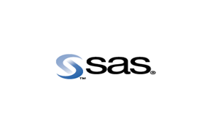
Conclusion:
References:
http://support.sas.com/documentation/cdl/en/lrcon/62955/HTML/default/a000992094.htm
https://www.ssc.wisc.edu/sscc/pubs/4-18.htm
So SAS helps us for –
Building dataset
Data cleaning
Manipulation of data
Report generating
Analysis by various graphs

Slide 7



